Slide 1
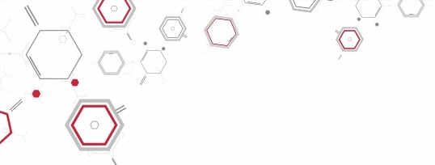
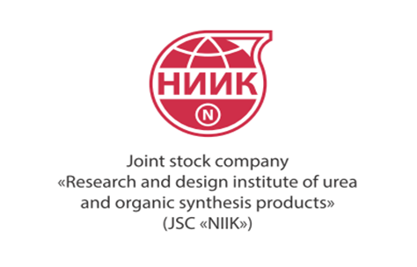

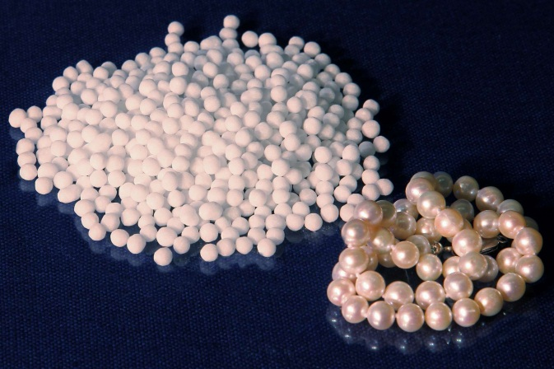
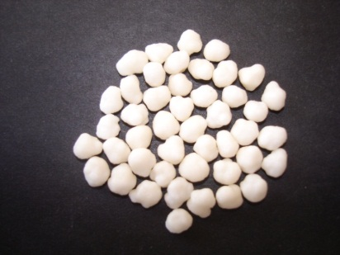


What Are the Advantages of Urea Production?

Slide 2
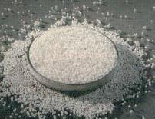
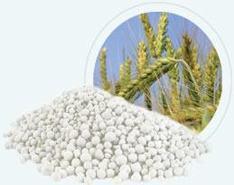

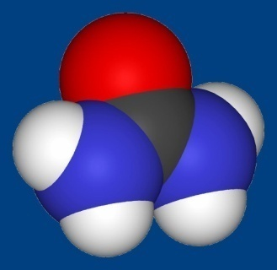

Urea – high efficiency nitrogen fertilizer with 46, 2% nitrogen content.
Urea is being manufactures according to GOST 2081-92.
Two urea grades are produced: grade A and grade B.
Urea application
Chemical industry (grade А)
Agriculture
О
Raw material for urea- aldehyde resins (synthesis of melamine, hydrazine and other products, including pharmaceuticals
use of urea in the petroleum for purification of oils and motor fuels from paraffin
Animal farming
(grade А)
Plant cultivation
(grade B)
=
С
H₂N
NH₂
Natural alternative to protein in livestock feeds
Universal fertilizer suitable for practically all kinds of soils and crops
Suitable for FOLIAR application

Slide 3

The phenomenal growth of global urea consumption
TARGETS
We need to find alternative to non renewable recourses
We need to feed the growing population
HOW TO ACHIEVE
LOOKING FOR ALTERNATIVE ENERGY RESOURCES INCLUDING BIOFUELS INCREASING
INCREASING FOOD PRODUCTION AND CROP YIELDS
Limited arable land
Land degradation
Competition for arable land use
PROBLEMS
SOLUTIONS
INCREASE CROP PRODUCTIVITY
INCREASE NITROGEN IN SOIL
AMMONIUM NITRATE (34,4% N)
UREA (46,3% N)
INCREASED INDUSTRIAL CONSUMPTION
UREA: INCREASE IN DEMAND

Slide 4

Factors Determining Profitability of Urea Production
Natural gas prices
Urea prices
Production profitability – up to 90%

Slide 5
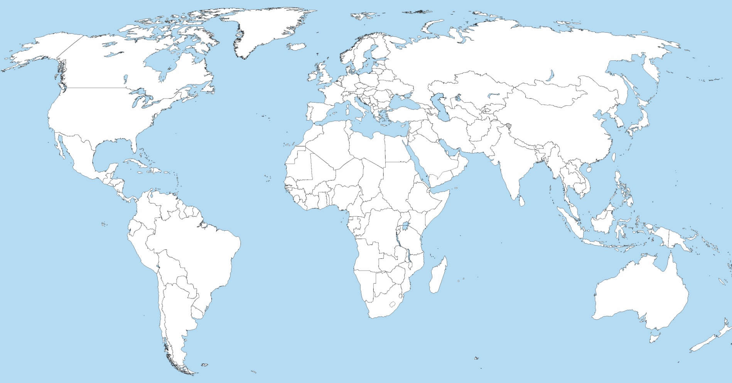
Supply/demand balance in the world market
million tonnes per year
- deficit
- surplus
Western
Europe
Eastern Europe
and Central Asia
North
America
- 2,2
Central
Europe
10,7
- 5,1
1,1
Western
Asia
South
Asia
Eastern
Asia
0,6
13,6
- 11,6
Africa
2,8
Latin
America
- 4,5
Oceania
2012
* - according International Fertilizer Industry Association (IFA)

Slide 6
New capacities expected to be commissioned in 2015
New urea projects
Start-up | Location | Company | Capacity, thousand tons per year
2012 | Russia, Veliky Novgorod | Acron | 330
 | Russia, Cherepovets | Cherepovetsky Azot | 500
 | Egypt, Damietta | MOPCO | 660*2
 | Qatar | Qafco | 1 300
 | China, 15 plants |  | 8 000
2013 | Abu-Dhabi | Fertil | 1150
 | Venezuela, Jose | Pequiven | 730*2
 | Egypt, Aswan |  | 630
2012-2014 | Vietnam, Ninh Binh |  | 1700
 | Vietnam, Ca Mau
 | Vietnam, Habac
by 2014 | Uzbekistan, Navoiy | «Navoiyazot» | 500
 | China |  | 4 000
 | India, Jagdishpur | Indo Gulf Fertilizers | ~6 550
 | India, Gadepan | Chambal Fertilizers and Chemicals
 | India, Hazira | Kribhko
 | India, Thal | Rashtriya Chemicals and Fertilizers
 | India, Babrala | Tata Chemicals
 | India, Panagarh in Wesy Bengal | Matix Fertilizers and Chemicals
Source: IFA, AFA

Slide 7
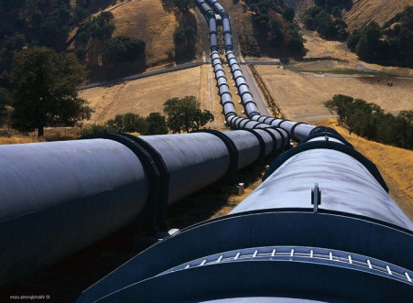
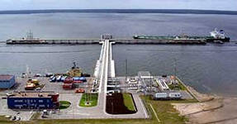
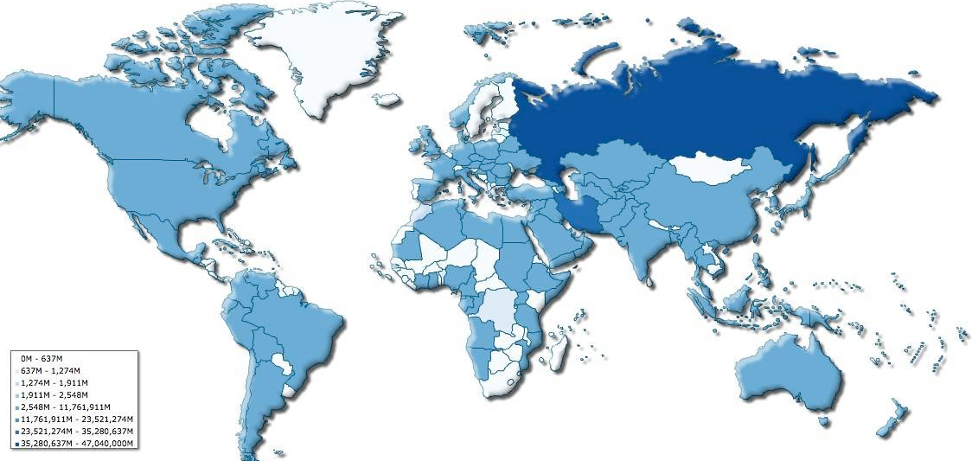
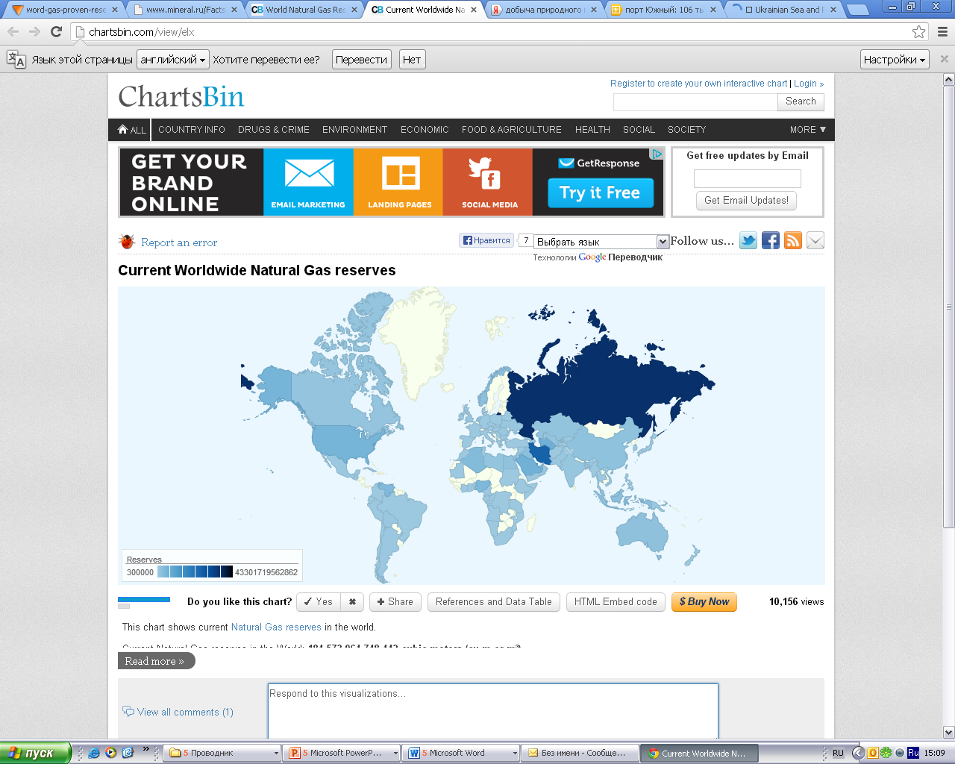
Russia: strategically advantageous location
The important advantages of launching new urea production facilities on the territory of Russia
- Availability of rich and effective raw material recourses
- Natural gas at lower price
- Well-developed infrastructure
- Large- scale logistics network
- Direct access to the sea
- Government support
- Predictable political environment
Natural gas reserves in the world
Shale gas:
an alternative energy
Disadvantages:
difficult to reach compared
with natural gas
uncontrolled methane gas
emissions
degradation of groundwater
quality
high production cost
Political instability in the Middle East

Slide 8
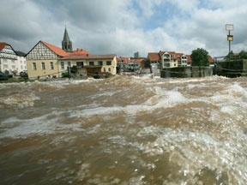

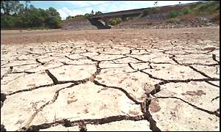
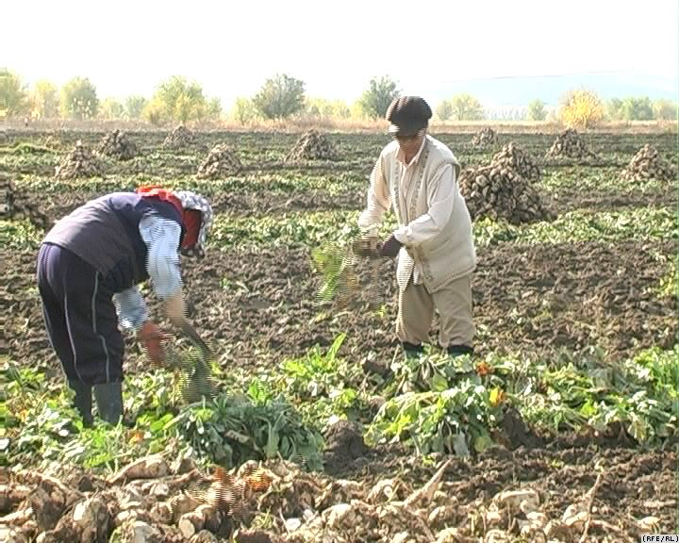
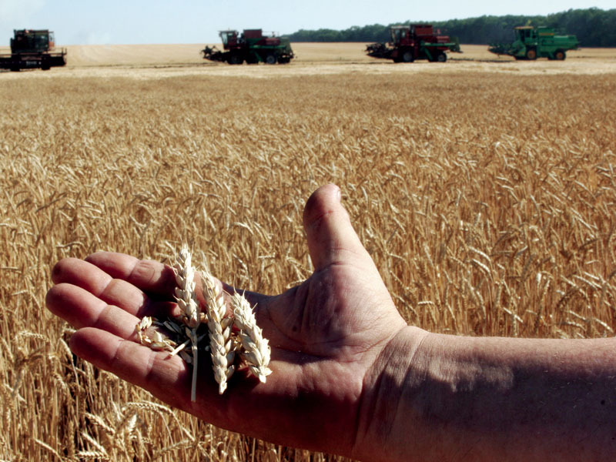
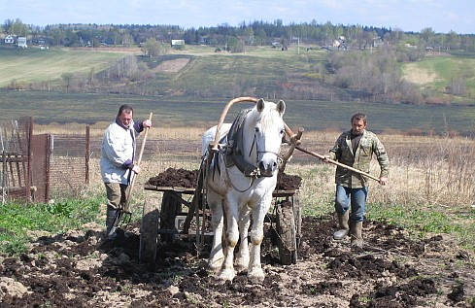
Growing demand attracts increase in urea output
in Russia and former USSR countries
TASK
RESTORING SOIL FERTILITY AFTER NATURAL DISASTERS
SOLUTION
UREA APPLICATION RATE INCREASE

Slide 9
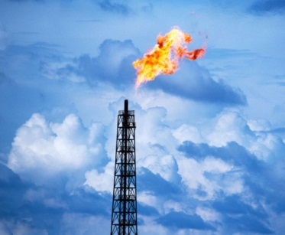
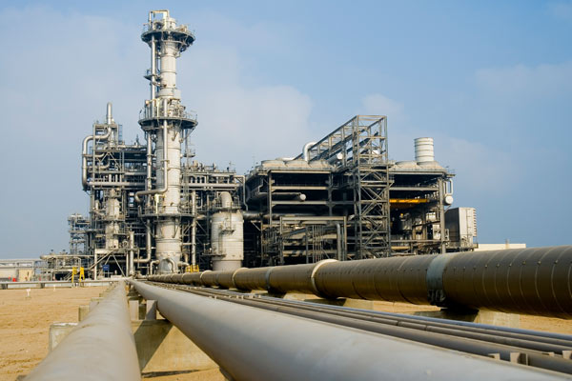
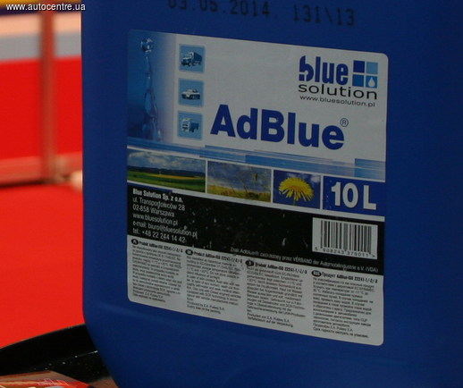
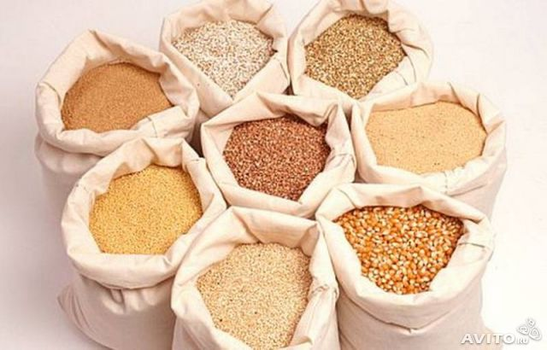
Growing demand attracts increase in urea output
in Russia and former USSR countries
Natural gas availability
ADVANCED GAS PROCESSING
TASK
SOLUTION
CONSTRUCTION OF NEW COMPLEX FERTILIZERS, ADBLUE, MELAMINE PRODUCTION UNITS

Slide 10
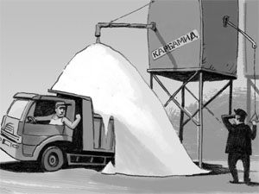
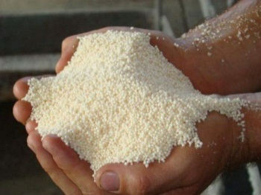
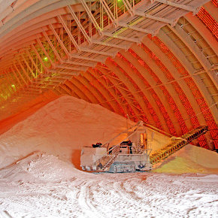
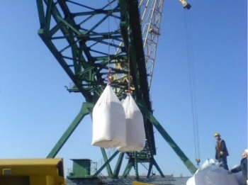
Growing demand attracts increase in urea output
in Russia and former USSR countries
TASK
MAINTAINING AND/OR
INCREASING EXPORT VOLUMES
1. Active position
of companies on promising export markets:
countries with high domestic gas prices and /or
having no possibility to extract gas
countries with low crop yields
countries with low application rate of N fertilizer
countries with fast growing population
countries exporting agricultural products
current importers of Russian fertilizers
SOLUTIONS
2. Reducing logistics cost in a total cost of urea production
(increasing rail car fleet sizing, construction of new port terminals etc)

Slide 11
Urea Production Units
Estonia
RUSSIA
Lithuania
Belarus
Uzbekistan
Ukraine
Turkmenistan
Tajikistan
Units commissioned between 1960 and 1970 years - 31
Units commissioned in 1980s - 14
Units commissioned in 2000s (new or relocated) - 4
Newly constructed units - 1
Total installed capacity of urea units in Russia is app. 7,8 million tons (end of 2012)

Slide 12
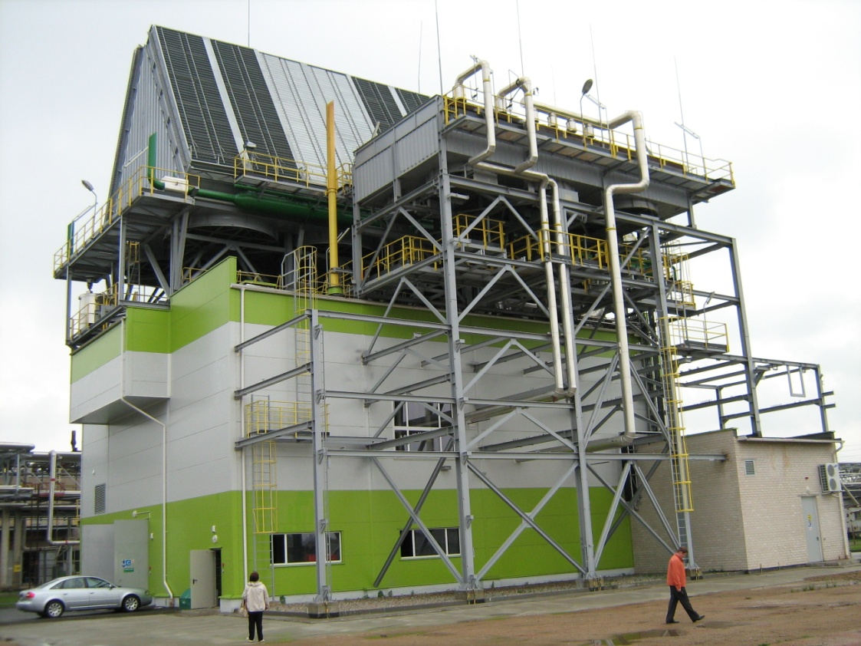
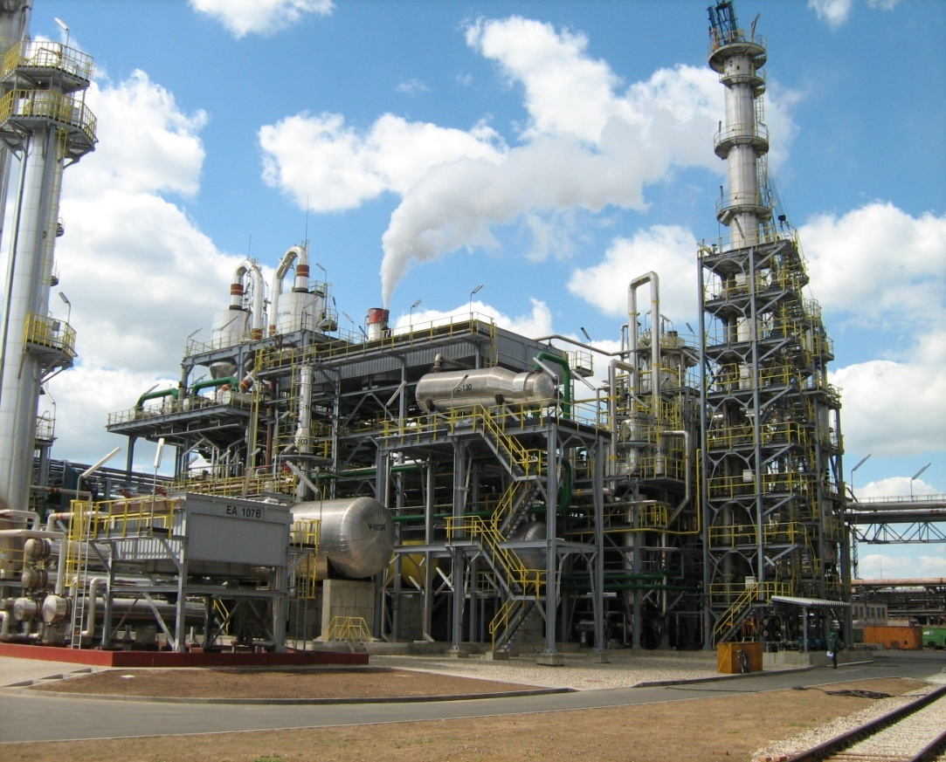
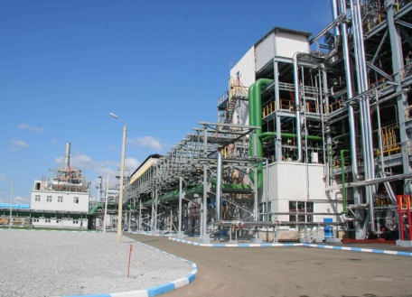
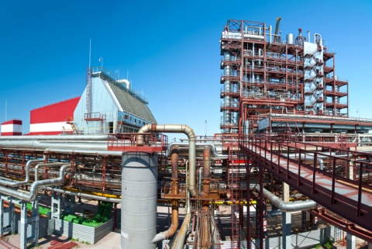
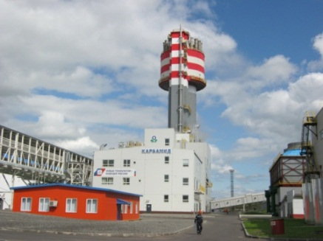
New urea plants in Russia and CIS countries
built using design projects of NIIK company and with its participation.
New urea plant based on second-hand equipment
at АB «Achema» (Lithuania, Ionava)
Capacity=500 TPD-based on a second- hand unit relocated from Angarsk city, 2006-2007
Capacity= 1000 TPD– based on a second-hand unit relocated from Manfredonia (Italie), 2008-2010
«NAK Azot»
Urea plant based on second- hand equipment
from Panchevo (Serbia), 2007-2010
Urea plant based on second- hand equipment
from Manfredonia (Italie)
«Acron»
Veliky Novgorod, 2007-2012
«Cherepovetsky Azot»
Urea plant,
2008-2012

Slide 13
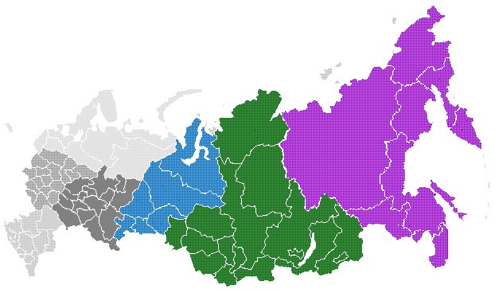


Promising ammonia-urea projects in Russia
Baltic Urea Plant
EuroChem - Kingisepp
Cherepovets
-PhosAgro
Baltic sea
Ammonia~ 1,0 mln TPY
Urea~ 1,2 mln TPY
Ammonia
~0,75 mln TPY
Gas Chemical facility
Ammonia
~0,75 mln TPY
USA
Western Europe
Ammonia - 2,1 mln TPY *
Urea - 2,0 mln TPY *
Methanol -1,0 mln TPY *
South America
?
Yamal
USA
South America
USA
South America
Europe
Middle East
Samara
region
India
China
Pacific ocean
Black sea
ЕuroChem - Nevinnomyssk
Rossosh
New ammonia production units
Ammonia~0,75 mln TPY
Urea~1,2 mln TPY
Ammonia-1,7 mln TPY
Urea-3,0 mln TPY
Ammonia
~0,49 mln TPY
New ammonia-urea-methanol complex
* Capacity of the first production train (second production train capacity is similar)

